Slide 1
ERAU ASCEND! Attitude determination
Andrew Grant

Slide 2
Overview
Flight Objectives
Instruments
Data
Conclusions
Future Goals

Slide 3
Flight Objectives
Determine the position and motion of our payload
Positions
Velocities
Accelerations/Forces
_
ω
_
F
_
S

Slide 4
Instruments
Acceleromoter
Determine the forces acting upon the payload to determine X-Y-Z translations
Gyros
Determine the rotations acting around the X-Y-Z axis to determine relative reference axis for acceleromoter
Sun Sensor
Use multiple solar cells (3-4) to determine the location of the sun with respect to the coordinate frame of the payload

Slide 5
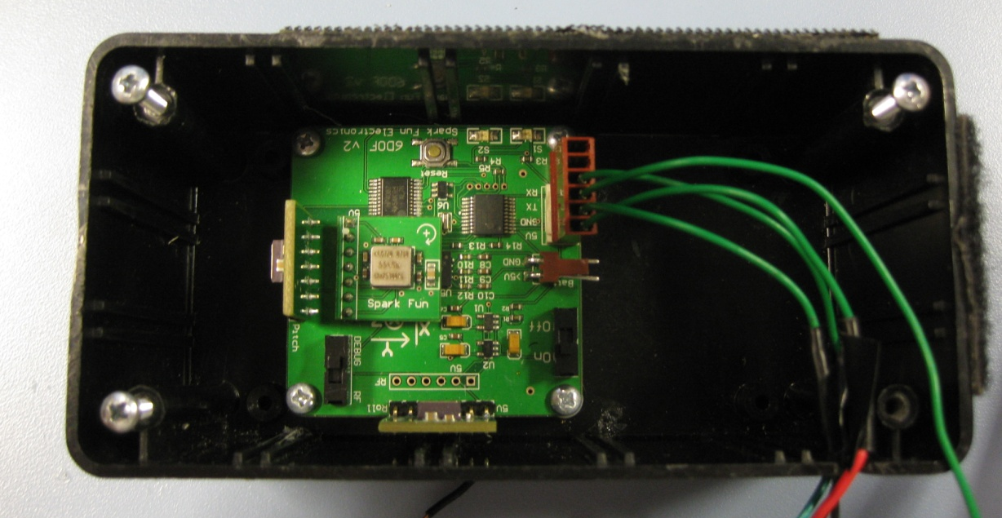
Instruments
Sparkfun IMU 6 degrees of freedom
±1.5g-6g Three Axis Low-g micromachined Accelerometer
3-ADXRS300 ±300°/s Single chip yaw rate gyro with signal conditioning

Slide 6
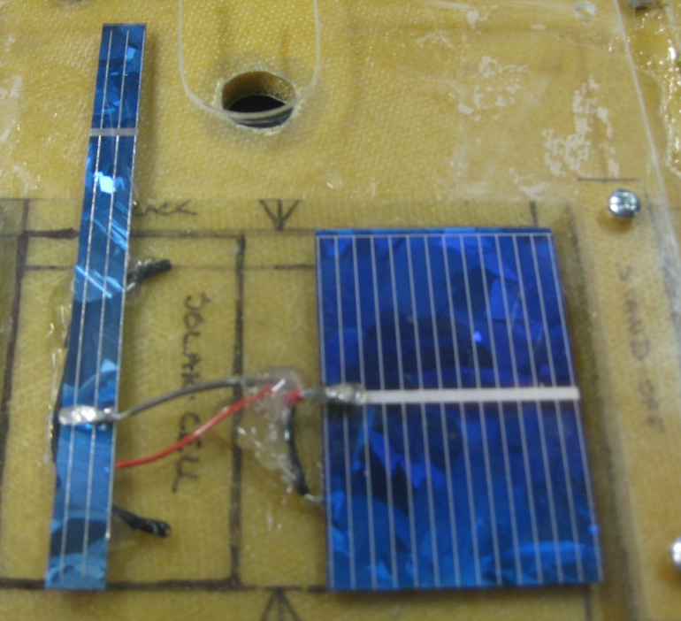
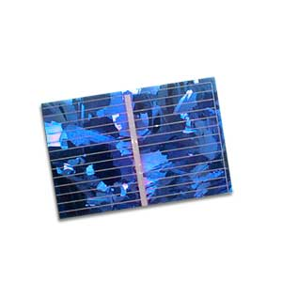
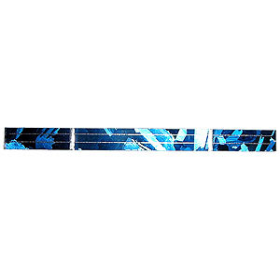
Instruments
Solar Sensor
.45V 200mA Silicon Polycrystalline Solar Cell
Polycrystalline Silicon Solar Cell 0.5V 400mA to 500mA
Source: www.goldmine-elec-products.com

Slide 7
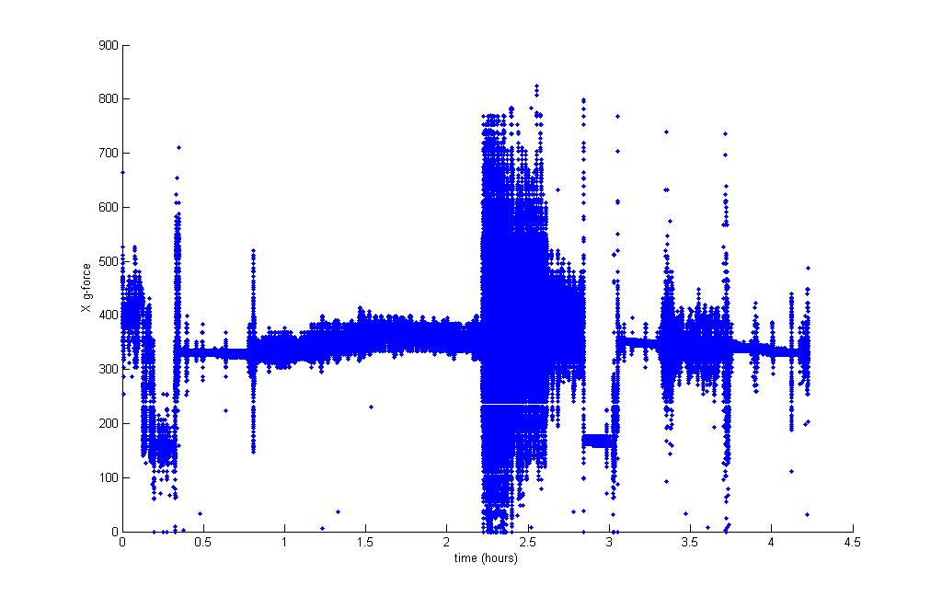
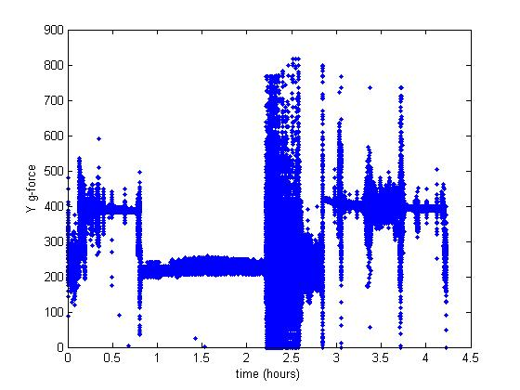
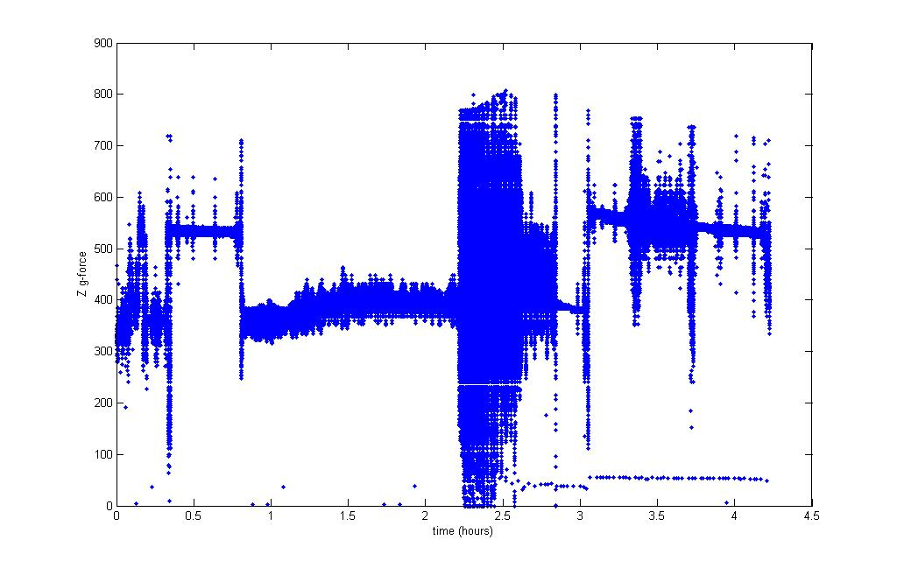
Data-Acceleromoter
Flight launch November 22, 2008
The Y-direction is the Direction of the Earths Gravitational Acceleration. (above)

Slide 8
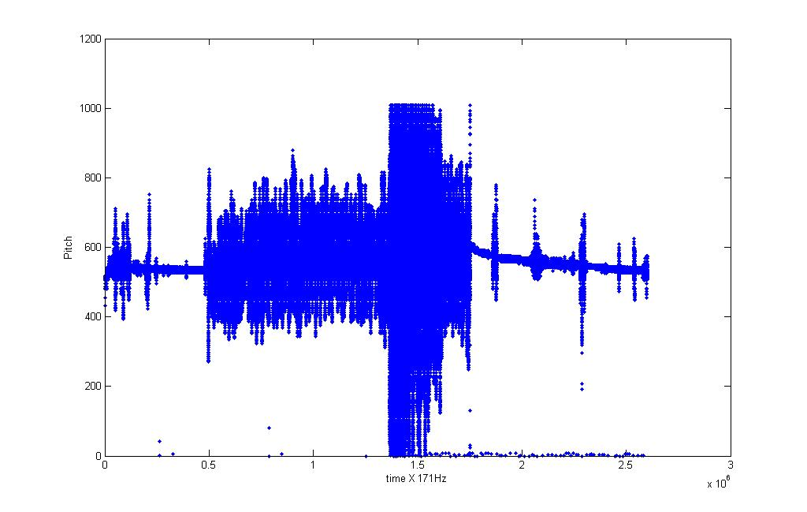
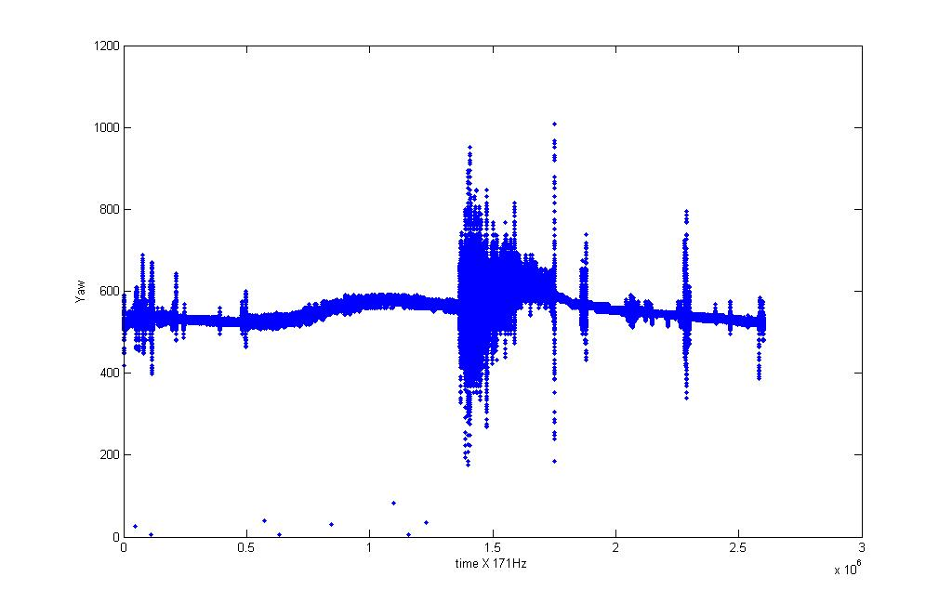
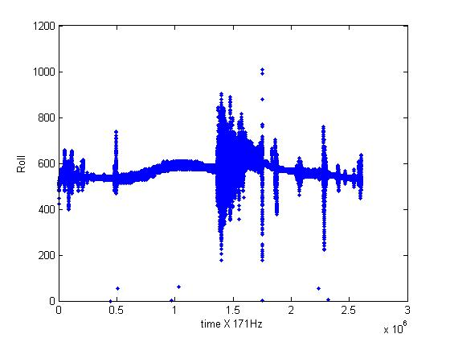
Data-Gyros
Flight launch November 22, 2008

Slide 9
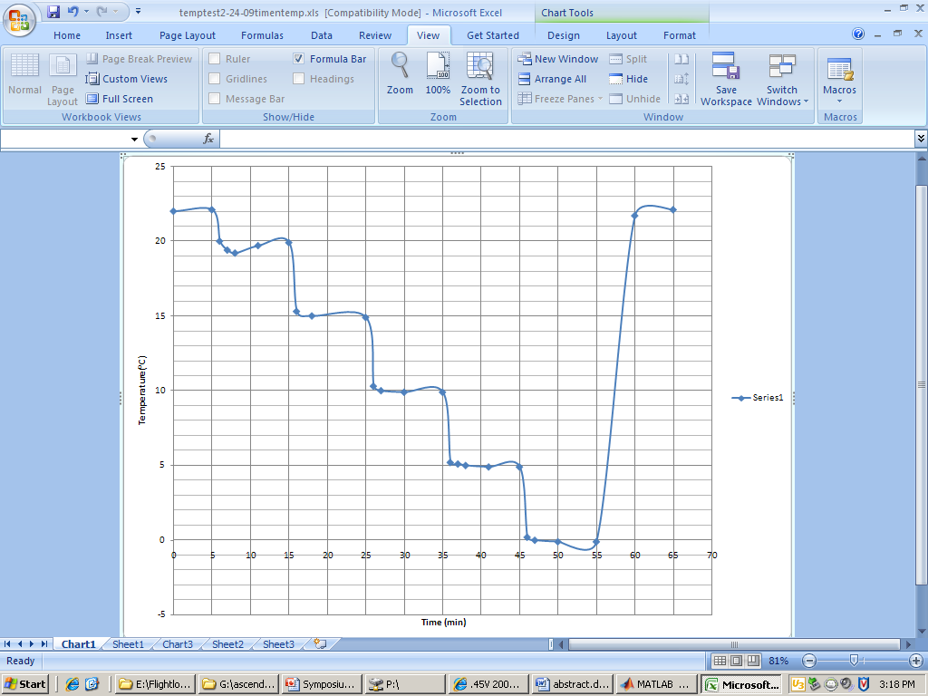
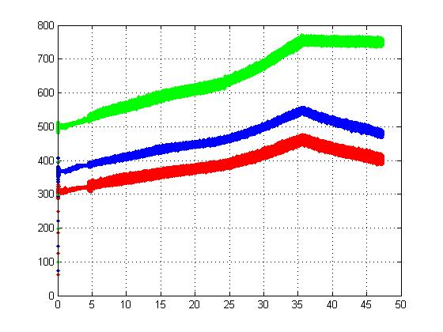
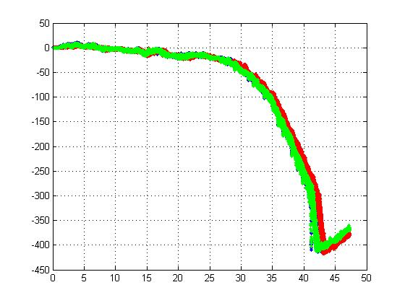
Data-Calibration
Inconsistent Accelerometer readings for temperature fluctuations (above)
Non-linear/poor functioning gyros at temperature fluctuations (left)

Slide 10
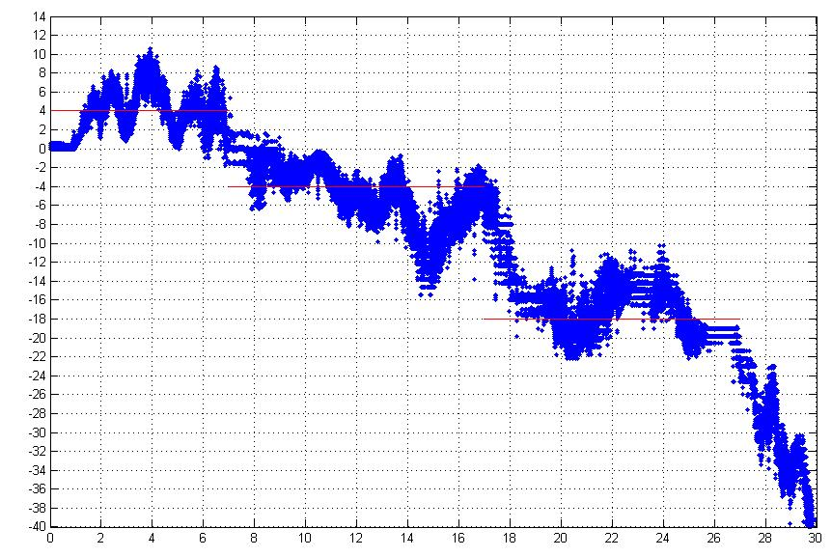
Data-Calibration
Comparable for first part of temperature calibration test

Slide 11
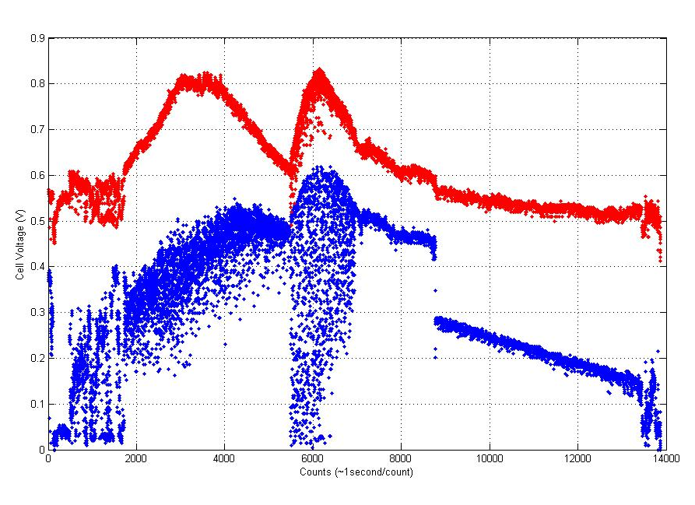
Data-Solar

Slide 12
Conclusions
IMU
Received Launch Data
Need to calibrate data to temperature fluctuations
Calibration Techniques Failed (Poor IMU Quality)
Solar Cells
Received information on voltage change with temperature and altitude.

Slide 13
Future Goals
Further develop and test solar cells to be able to acquire the position of the sun for payload attitude
Develop more reliable way of acquiring Attitude
Develop an attitude control system

Slide 14
Future Goals
Solar Sensor

Slide 15
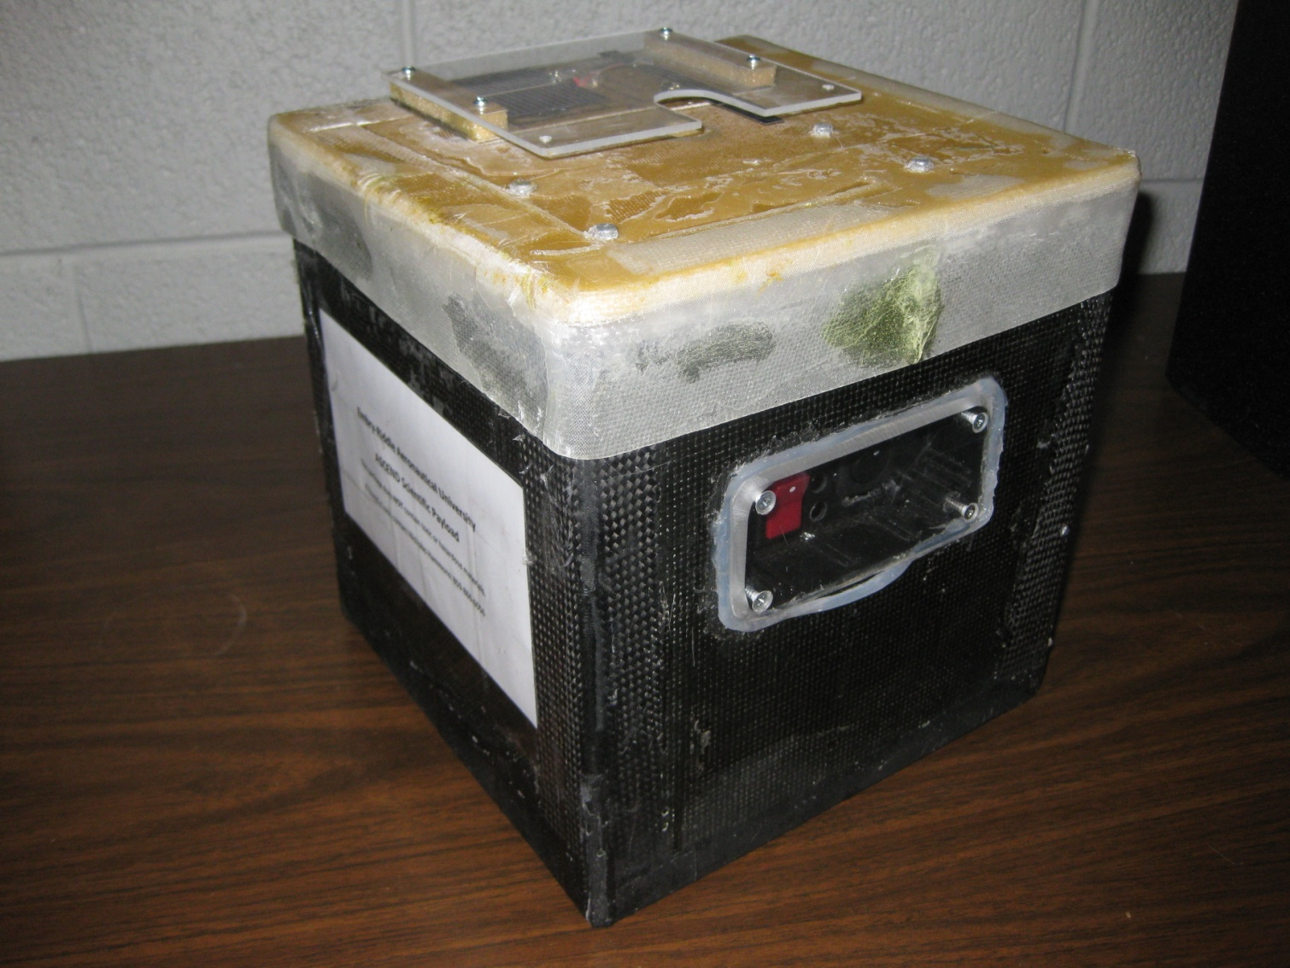
Questions?

Slide 16
Data Analysis
Geimi DeLarge

